Slide 1
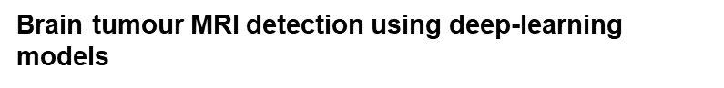
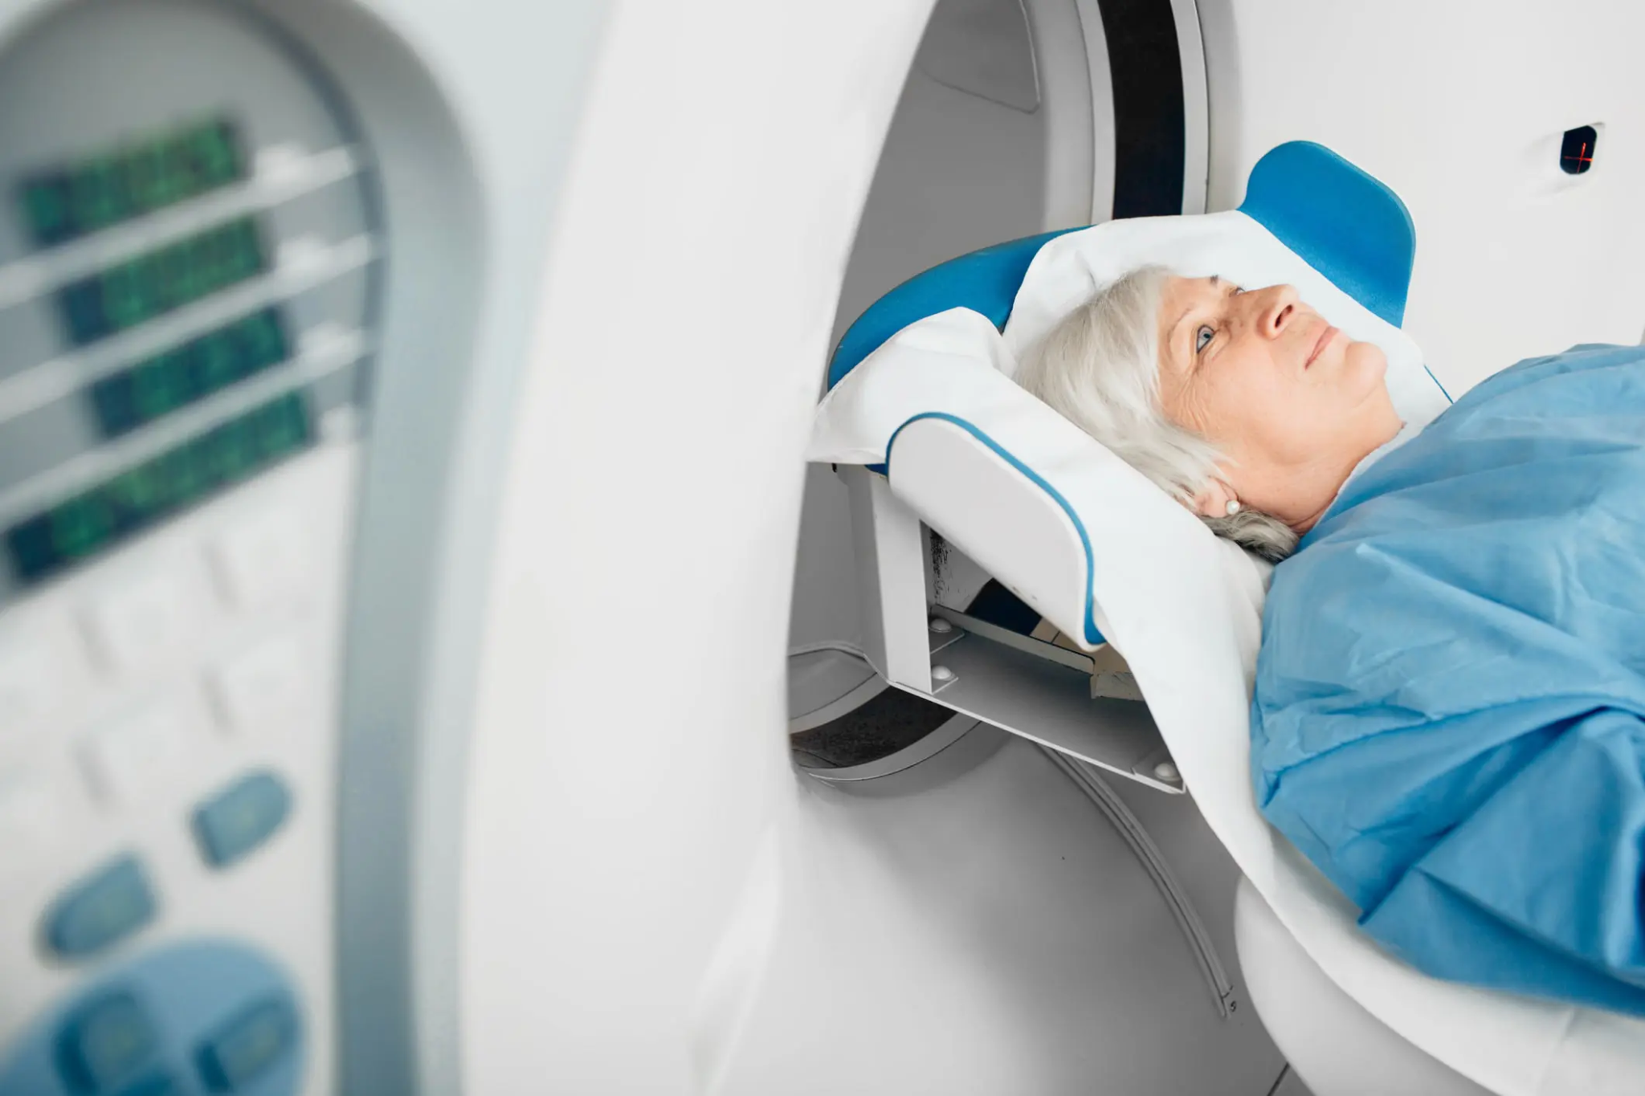
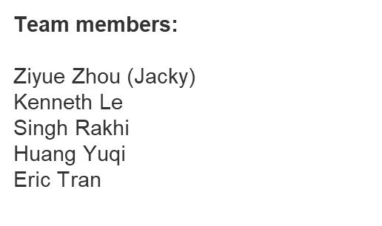
Project 4 - Group 2

Slide 2
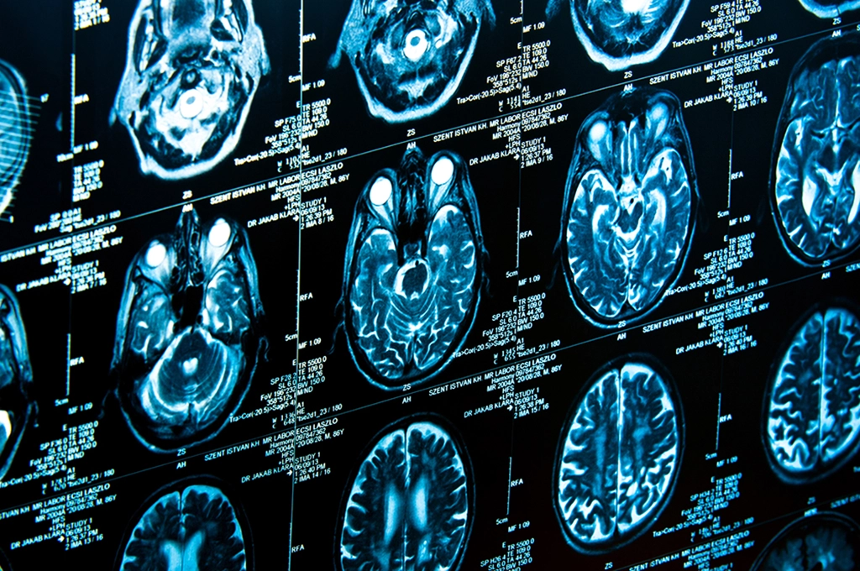
Project Overview
Brain tumors are a wide variety of vicious oncological disease. Which pose significant health threats to people’s lives. Due to its progressive nature. Patients usually suffer from poor prognosis and low quality of life even after vigorous treatments, if not detecting in early stage.
Moreover, the modern method for detecting the tumour presence still primarily rely on MRI/PET/CT scans. Thus, detecting tumour presence reveals its significance for combating this deadly disease.
From the data analyst/scientist’s perspective, it is crucial for us to use various models, to achieve early detection for patients who are suspected to have brain tumor, in conjunction with the collaboration of multidisciplinary teams. Therefore, an accurate diagnosis and timely treatment can be delivered to patient.
Therefore, the goal of this project is to use the selected datasets to train various deep-learning models, to examine the effect that whether any model can achieve a satisfactory detection and classifications score for a certain types of brain tumour

Slide 3
Dataset
Brain Tumour Classification (MRI). Bhuvaji, S. et.al., (2020). Kaggle. https://doi.org/10.34740/KAGGLE/DSV/1183165
Why pick this dataset?
Our goal is to train various deep learning models, in order to detect and classify brain tumors from given MRI images. This kaggle dataset is already cleaned and splited into train/test subset with 4 classes of tumour respectively. Ready for usage.
Data loading & Preprocessing
Noticeably, this is one of the most essential steps for any model training. So the dataset we used requires to load the train/test set and convert them into normalised and scaled format before use. Therefore, the goal here is to examine the data’s original format, Then apply data transformation pipeline: (resizing, normalisation, rescaling +/- data augmentation).
Ethical Considerations
The main focus of this part is that due to this dataset and the natural of our project contains medical information. So,
ensuring the data does not contain any personal identifiable information(PII) before usage is essential for data privacy concerns. Thus, the dataset in kaggle did not contain any PII and has the suitable license for training, practicing, and educational purposes. For this details, please visit our github repository as well as the the kaggle website.

Slide 4
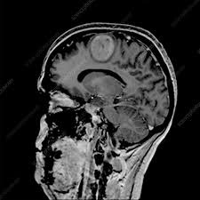
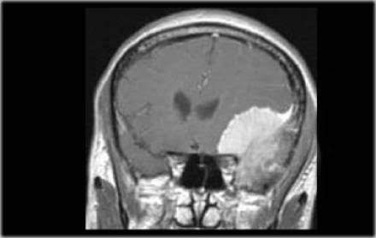
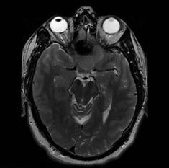
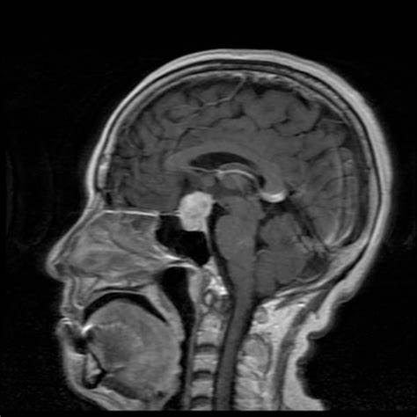
Some Images of the dataset
Glioma Tumor
Meningioma Tumor
No Tumor
Pituitary Tumor

Slide 5
Approaches for model selection:
1: Basic CNN constructed from scratch
The team chose to train self-build CNN model by arbitrarily setting Conv2D and Max Pooling layers, with Dropouts layers as well. But result not ideal after initial test. So more optimisation trails applied. However. Still didn’t achieve the required accuracy (>= 75%). Therefore, other model architectures were used to enable further exploration.
2. Pre-Trained Model & Transfer Learning
- The team then chose to use pre-trained models such as Xception, ResNet50, U-NET etc + connected Desne sequential layers as output. Which can extract complex medical imaging where patterns might be subtle and harder to detect by other model.
- The core approach here is to leverage the advantages of trained params’ weights from these pre-trained model.
- Freezing layers were applied (“feature extraction layers”) enables faster convergence and more stable regularisation.
3. Comparison of models
In this stage. All various models were trained & optimised after several trails. So the group select one model which achieves the highest testing accuracy. The result were also confirmed by conducting confusion matrix ran on testing set, as well as obtained the classification reports.
The best performing model for our group is the ‘U-NET’ model. Which this will be discussed in more detail later…

Slide 6
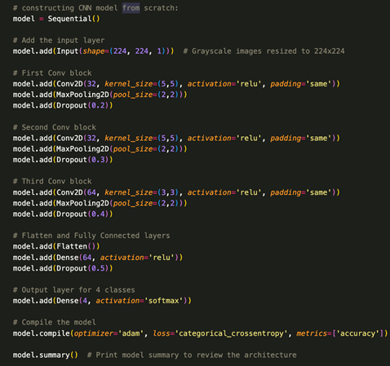
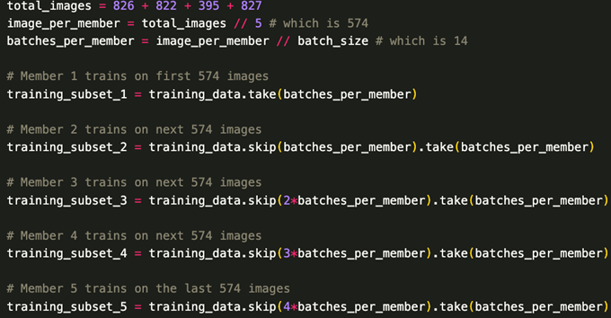
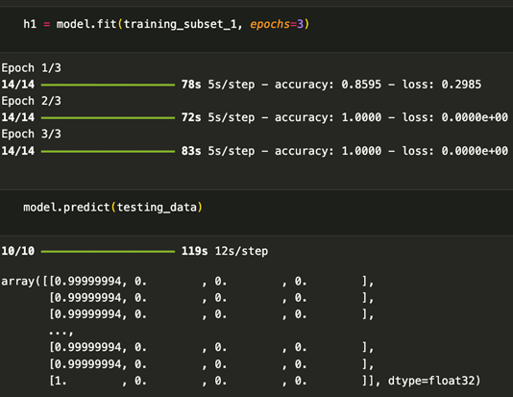
Issues with Initial Training

Slide 7
What model we used:
Transfer learning using pre-trained architecture:
ResNet50
ResNet50 is part of the Residual Network family, is a 50-layer deep convolutional neural network. ResNet50 likely helped identify complex features within brain tumor images, capturing fine details essential for accurate classifications .
Xception
Xception has the ability to capture detailed features in complex medical images with a more optimized approach, which is particularly helpful for detailed classifications like tumor identifications
U-NET
U-Net is a convolutional neural network architecture specifically designed for image segmentations. U-Net is ideal for task where precise pixel-level classification is essential, such as segmenting tumor regions in MRI images. It is widely used in medical imaging because it provides highly detailed and accurate segmentation outputs

Slide 8
Layer Freezing (Trainable = False)
What is Layer Freezing?
Layer Freezing is a process in transfer learning where we “freeze” the weights of some layers so they aren't updated during training. In Keras, this is done with Layer.trainable = false
Why is this important in Transfer Learning?
Freezing layers speed up training because only the unfrozen layers are updated This is especially useful with models, where training all layers can be resource -intensive.
Where do we apply Freezing
Typically, in ResNet50 and Xception, we freeze the lower layers which capture basic features like edges and textures. The final few layers are then fine-tuned to adapt the model specifically to our target data- MRI images - Allowing it to focus on recognizing tumor specific patterns

Slide 9
Step by Step Breakdown
Layer Freezing for Transfer Learning
Extended Training with more Epochs
Gradual Learning Rate Reduction
We started with pre-trained models (ResNet50, Xception, U-Net) and froze the lower layers to retain foundational features like edges and textures.
Giving the model ample time to learn complex patterns, we trained for it more epochs, allowing it to refine its understanding of tumor characteristics
We used ReduceLROnPlateau to decrease the learning rate whenever validation metrics (like Val_Accuracy or Val_Loss) Plateaued.
Data Augmentation
Batch Normalization and dropout Layers
Advanced Hyperparameter Tuning with Keras-Tuner
We applied data augmentation techniques such as rotation, flipping, zooming, and shifting, to artificially increase the size of diversity of our dataset
Batch Normalization was applied to stabilize layer outputs and improve training consistency. Dropout Layers with various dropout ratios were added to reduce reliance on any specific neurons, helping the model generalize
We used kera-Tuner to automate hyperparameter turning through Random search and Hyperband. This included tuning parameters like learning rate, dropout rates, Bach size, and the number of dense layer units

Slide 10
U-NET ARCHITECTURE

Slide 11
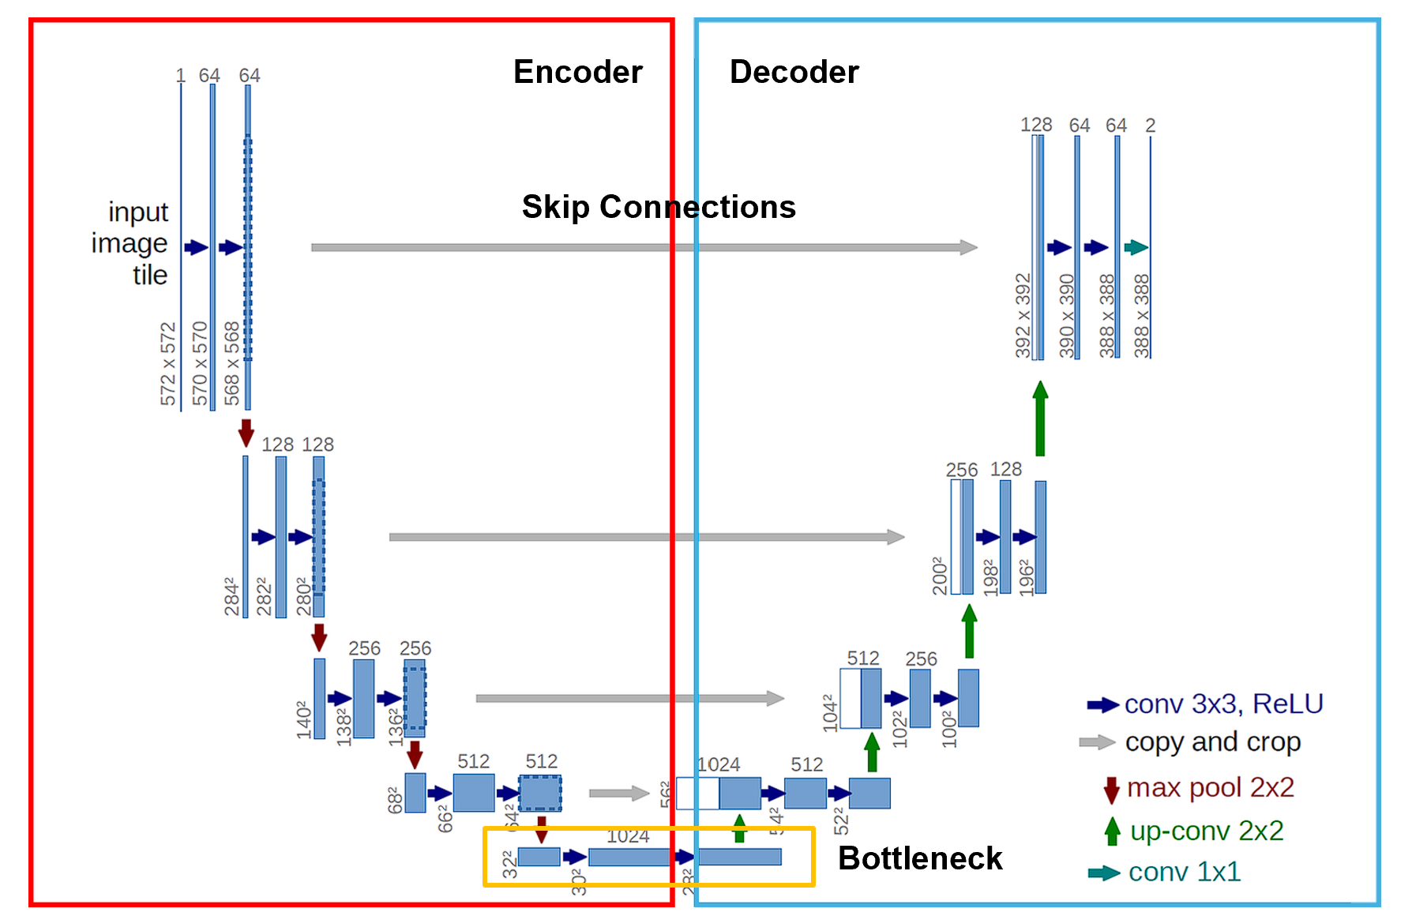

Slide 12
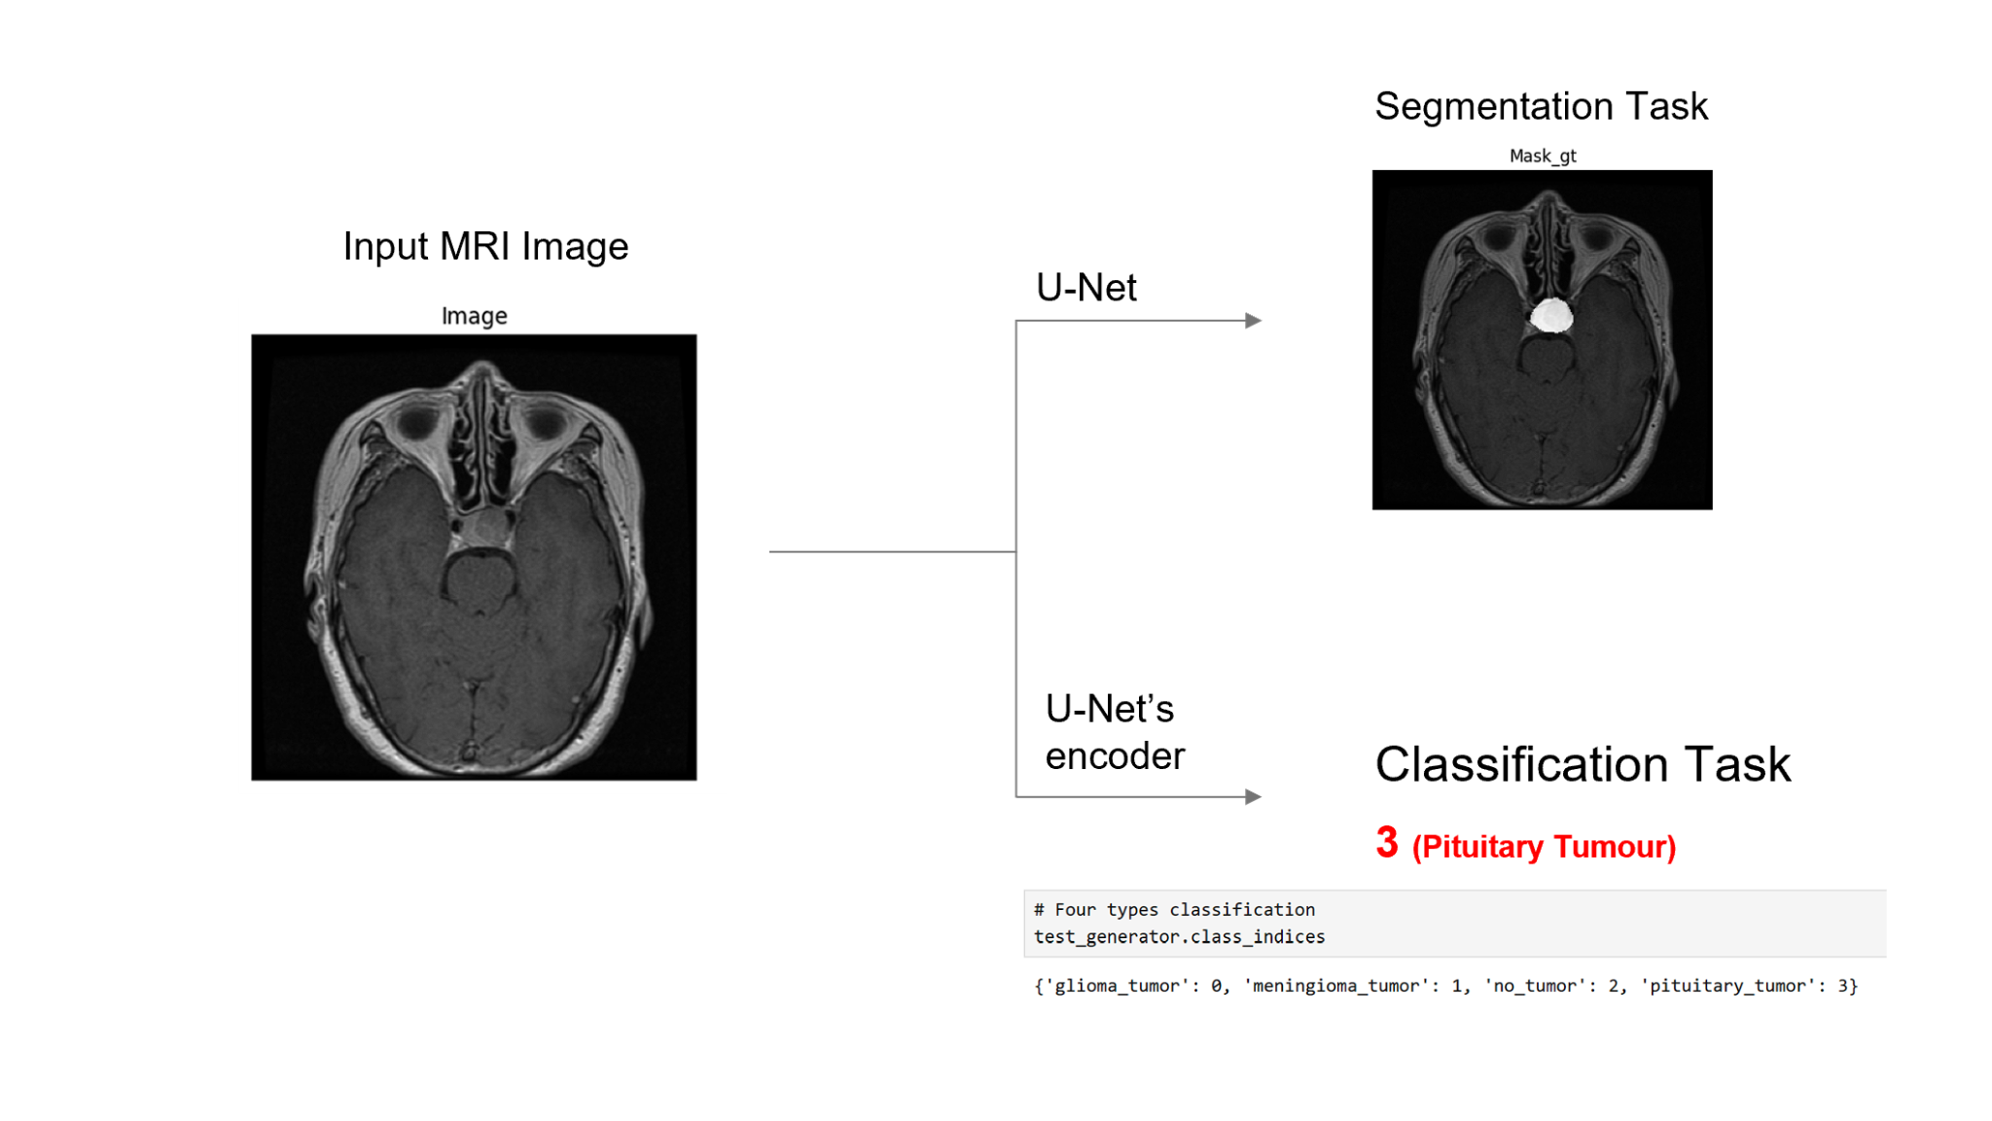

Slide 13
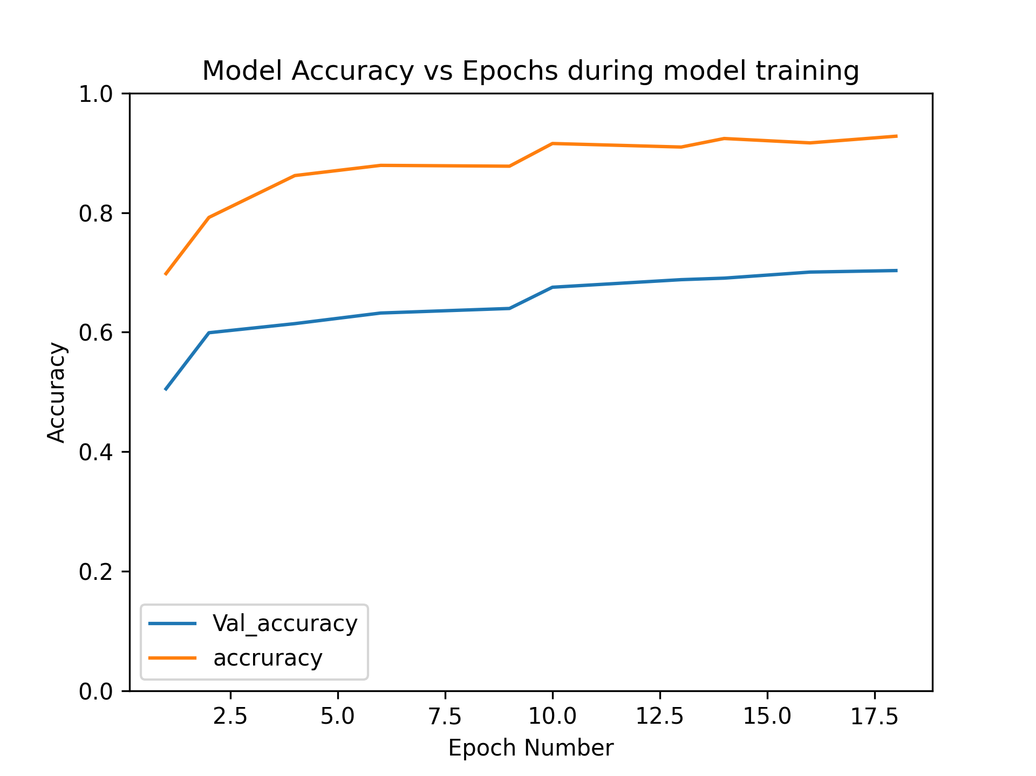

Slide 14
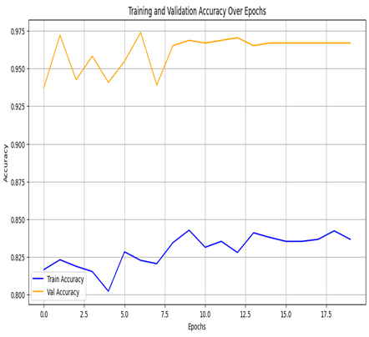
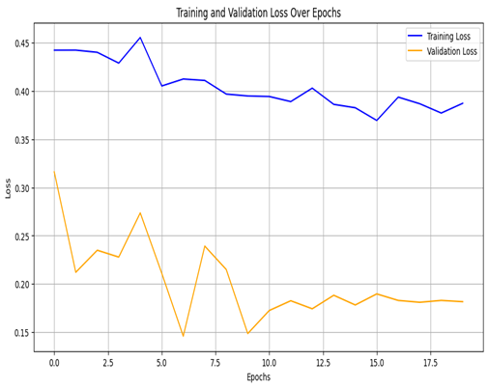
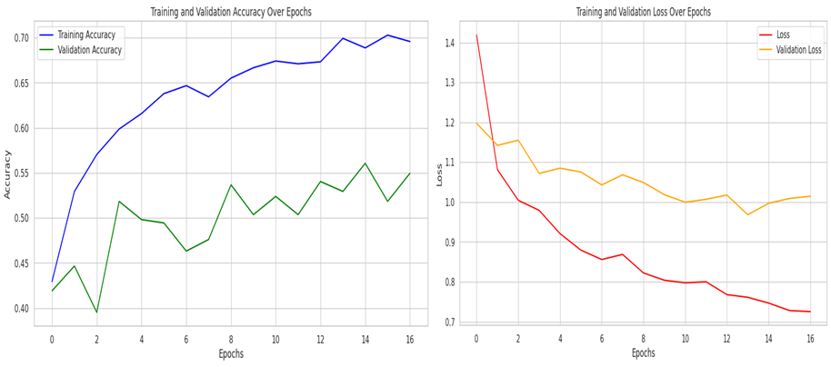
Plots of our training and testing results
MODEL 1:CNN Architecture (3 Conv2D Layers with Progressive Dropout)
MODEL 2: ResNet50 Architecture
•Architecture Type: Basic Convolutional Neural Network (CNN).
•Data Augmentation: Applied to increase training data variety and reduce overfitting
•Epochs: Trained over 20 epochs.
•Callbacks: Utilized to enhance training control, including early stopping and learning rate adjustments
•Performance: Accuracy reached up to 95% with a final loss of less than 18%
•Architecture Type: ResNet50
•Data Augmentation: Applied to expand the diversity of training data and help prevent overfitting.
•Epochs: Trained over 10 epochs.
•Performance: Validation accuracy reached approximately 55%, with a final validation loss of 0.6.

Slide 15
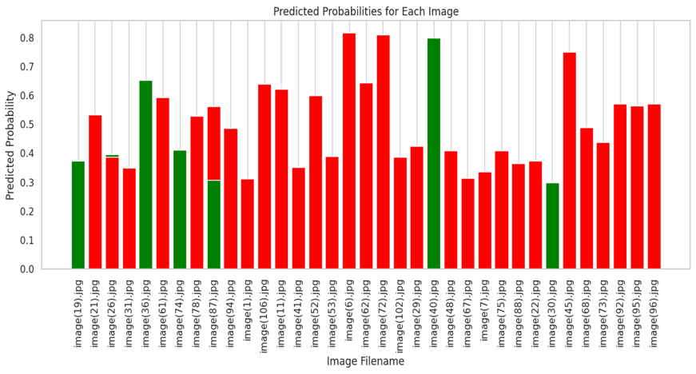
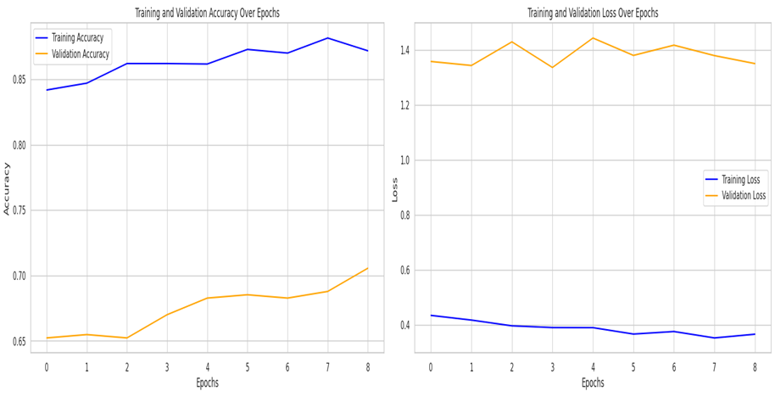
Plots of our training and testing results
MODEL 3:CNN Architecture (3 Conv2D Layers with Single Dropout)
MODEL 4:Xception Architecture
•Architecture Type: 3 convolutional layer is used with single dropout layer.
•Epochs: Trained with 20 epochs.
•Performance: Achieved a slight improvement in accuracy, with accuracy less than 30%
•Architecture Type: Xception model is used.
•Epochs: Trained with 8 epochs.
•Performance: Achieved a slight improvement in accuracy, with accuracy reaching up to 70%.

Slide 16
How the App Works
Step 2: Image Processing & Prediction
Step 1: Upload MRI Image
Step 3: Display Results
The user will select and upload an MRI image through the web interface
The uploaded image is processed and fed into a trained deep learning model, which analyzes the image and predicts the tumor type
The app will display the predicted tumor type along with the confidence level, allowing the user to view the results

Slide 17
Future Considerations
Need to perform more thorough data transformation before training the model:
( why? Because rubbish in model → rubbish out ( not going to obtain ideal results and model will learn from bad quality data and retain poor weights). Therefore, more effort should be spent on doing data preprocessing. As for our project. Some source images (actual brain part) are vary in size. So for better data quality, central cropping and trimming image should be applied.)
Consider carefully about data augmentation when training complex model with limited source data.
(Why? As for different deep-learning task. Model selection & construction is important. But meanwhile, overly augmented data might increase the image distortion & might confuse the model.
Like in our project, MRI scans contains anatomical landmarks which are served as crucial contour for model to recognise. To combat this issue, considering explore other option to plenish source data for training. As more complex model generally requires more abundant data to train for achieving good result.)
Consider adopting more powerful hardwares e.g: better GPU. (Yes this actually matters !)
(Why? Deep-learning is a heavily resource-expenditure task. From this project, we learned that computation power matters a lot when training the complex model with increasing amount of data. Some group member used native GPU to enable faster training & optimising. Some member used cloud platform resources to leverage cloud GPU/TPU etc.
Time constraint and if possible can explore further in image segmentation part further.

Slide 18
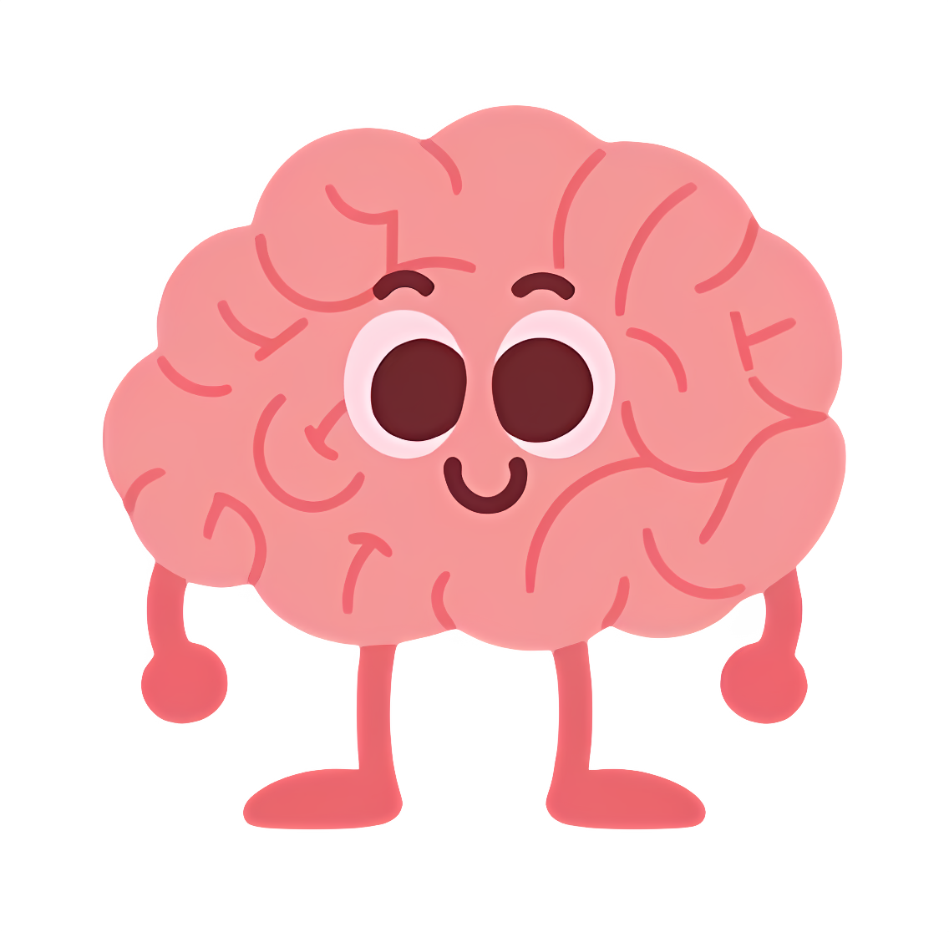
Thank you for listening

Slide 19

Demonstration of App

Slide 20

Questions?

